Slide 1
Implementation Plan:
Section 3 Staffing
Org Chart and Staffing Model

Slide 2
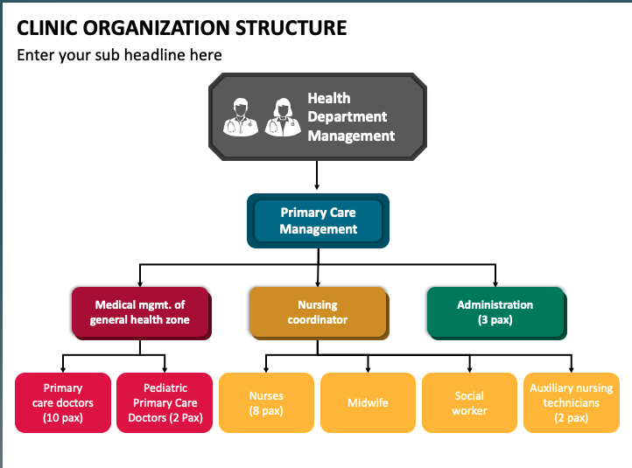
Sample Org Chart

Slide 3
Org Chart at Pilot Site

Slide 4
Sample PCBH Staffing Model
Behavioral Health Clinician
Primary Care Provider
Other roles?
PCBH Staffing Model
NAME, TITLE
NAME, TITLE

Slide 5
PCBH Staffing Model at Pilot Site

Slide 6
Sample CoCM Staffing Model
Behavioral Health Care Manager
Psychiatric Consultant
Primary Care Provider
Other roles?
CoCM Staffing Model
NAME, TITLE
NAME, TITLE
NAME, TITLE

Slide 7
CoCM Staffing Model at Pilot Site

